Slide 1
DREAM TEAM AGRO SOLUTIONS Pvt.Ltd
BUSINESS PLAN

Slide 2

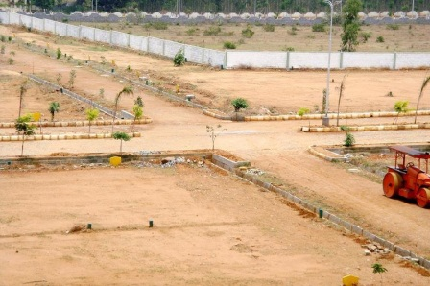
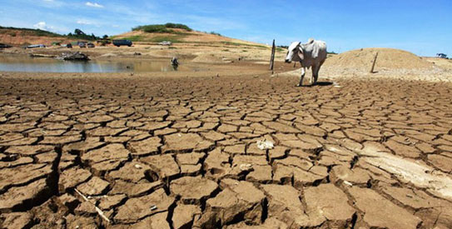
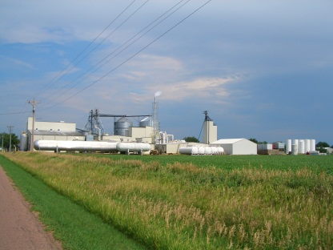

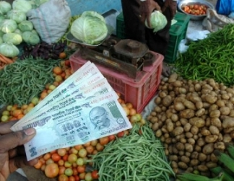
CURRENT SCENARIO IN AGRICULTURE
RESULT…..???

Slide 3
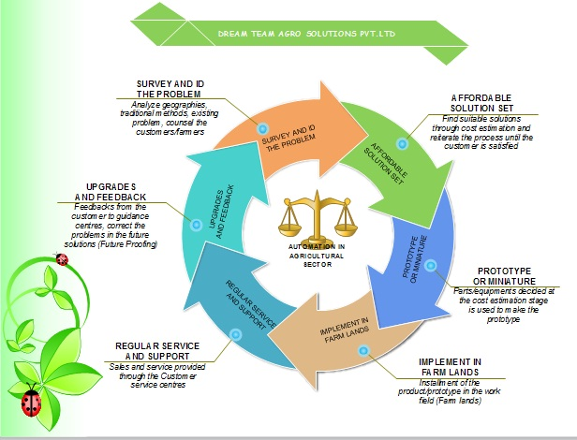
BUISINESS FLOW

Slide 4
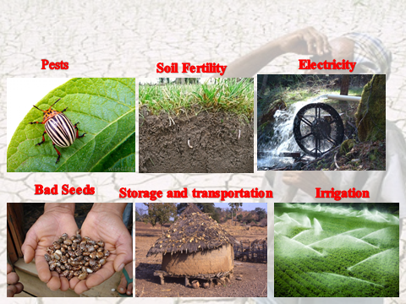
MAJOR PROBLEMS FACED BY FARMER

Slide 5
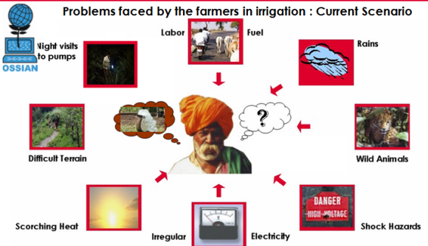

AUTOMATION IN AGRICULTURE:IRRIGATION

Slide 6
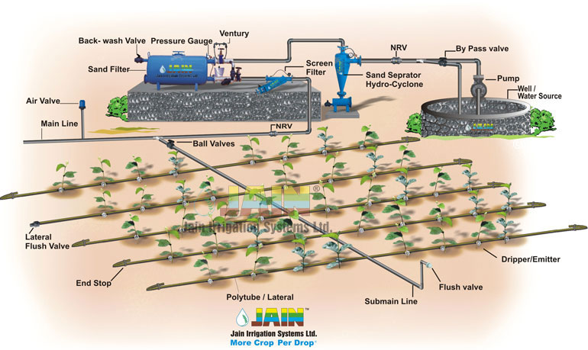
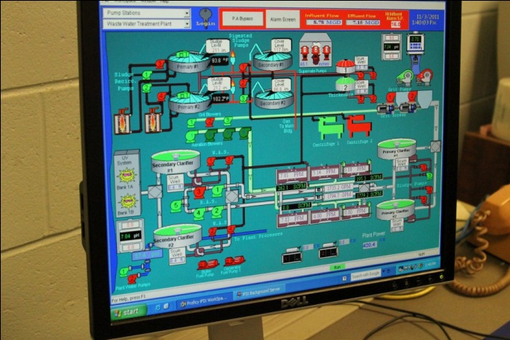
SOLUTION SETS

Slide 7
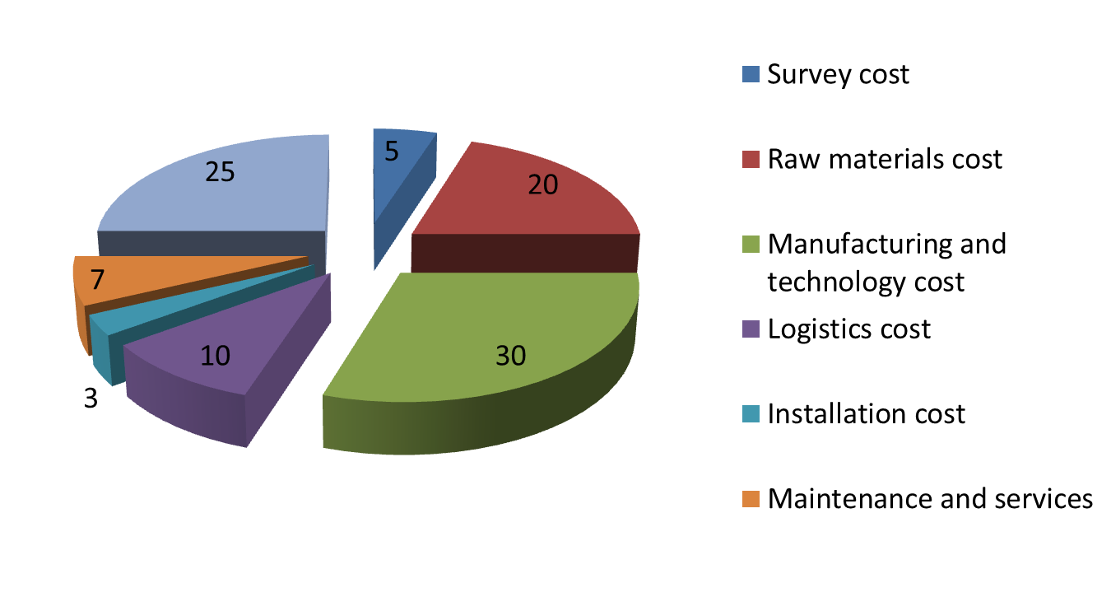
EXPENDITURE

Slide 8
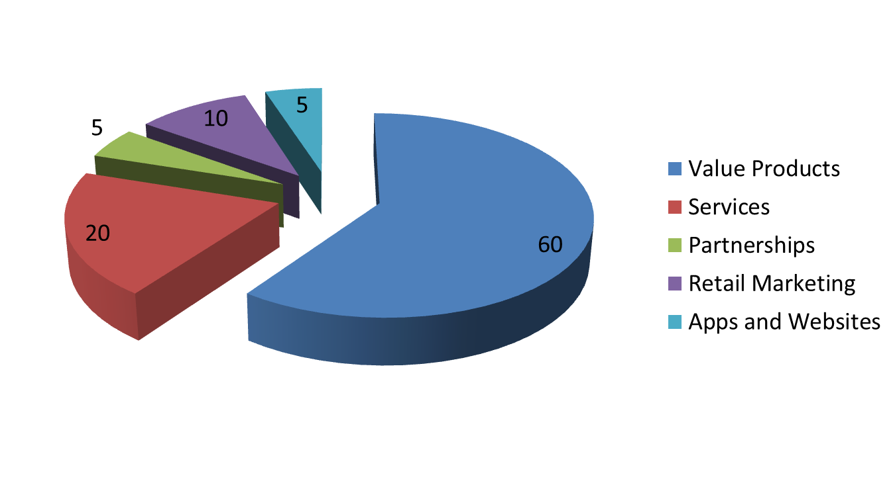
REVENUE

Slide 9
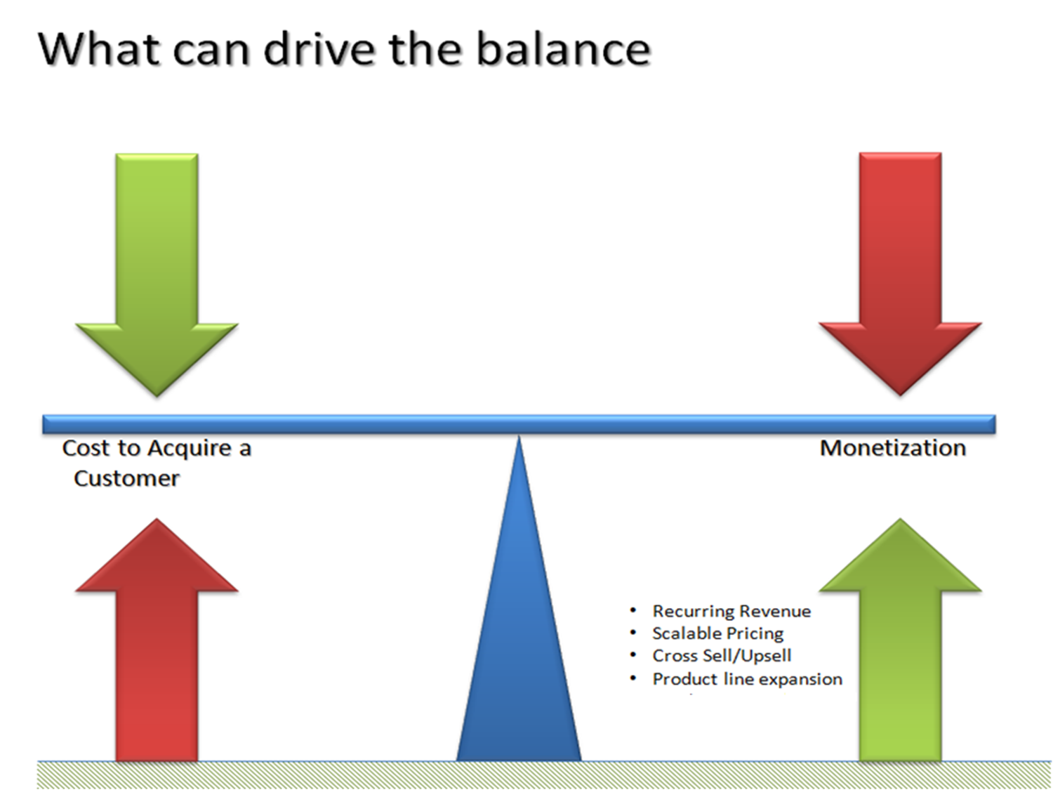
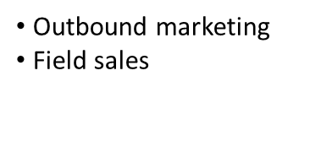
CONCLUSION
Inbound marketing
Free trials
Increase in product or service cost
Low customer satisfaction

Slide 10



